Slide 1
Refactoring project: Economic determinants of multidrug-resistant tuberculosis (MDR-TB)
Corinne Bintz
HMS 520
December 14, 2021

Slide 2
Overview of presentation
Summary of project
Goals
Existing code and repository
Overview of new scripts
Data prep
Modeling
Visualizations
Future directions

Slide 3
Summary of existing project
Summer research fellow in 2020 with the Summer Institute of Biomedical Informatics at Harvard Medical School’s Department of Biomedical Informatics
Farhat Lab under Maha Farhat, MD, MSc: translational lab combing genomics and informatics to understand and better control drug resistant tuberculosis and other infections
Used available health financing, economic and MDR-TB notification data in linear mixed models to understand the relationship between between health spending, country economic status, and rates of multidrug-resistant tuberculosis over time

Slide 4
MDR-TB
Despite being preventable and curable, tuberculosis causes 1.5 million deaths per year
The majority of the people who suffer from tuberculosis live in low- and middle-income countries (World Health Organization)
Multidrug-resistant tuberculosis (MDR-TB) occurs when the tuberculosis bacteria is resistant to at least the two most powerful drugs used to treat tuberculosis, isoniazid and rifampin (CDC)
Laboratory diagnostics that identify multidrug-resistant tuberculosis can help control its spread and improve treatment protocols.

Slide 5
The existing code
Two scripts: lmer_exp.R and tb_funding_analysis.R
Problems:
Intermixed pipeline of reading in, cleaning and merging data, making visualizations, and running models
Unnecessary datasets and variables no longer of interest
Poorly organized, causing difficulty in adding new data and modifying or adding new visualizations or analyses
Poor readability

Slide 6
Goals
Consolidate data preparation including reading in, cleaning, and merging datasets
Create and save one cleaned, final dataset to use for plotting and modeling
Create three distinct scripts for data preparation, visualizations, and modeling
Filter down to variables, visualizations, and models of interest and remove unnecessary code used in exploratory stage of project
Make all code more modular via the use of functions and distinct scripts
Organize directory with datasets, scripts, and visualizations
Increase use of data.table package for efficiency
Improve readability

Slide 7
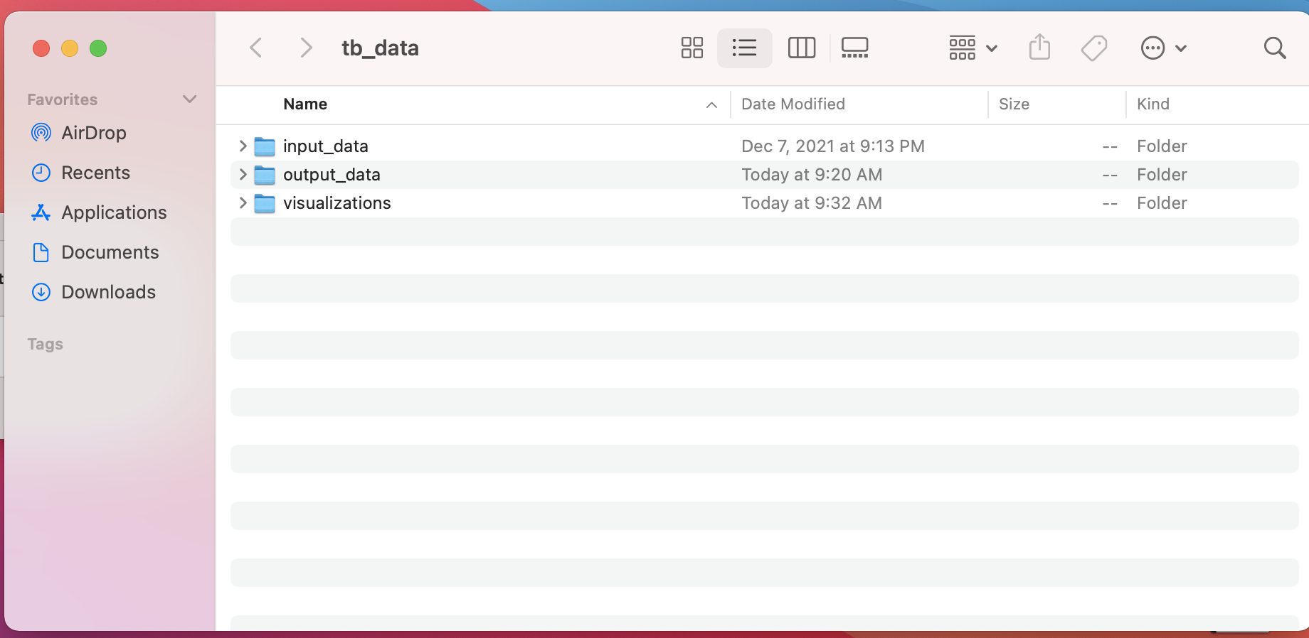

Slide 8
I. Data prep script
12 datasets: 4 from World Bank, 4 from WHO and 3 from IHME
Wide to long format
Cleaned each dataset down to iso3, year, and variable of interest
Wrote function to clean World Bank datasets
Merged with IHME location dataset to filter down to level 3 locations
Replaced all “..” with NA
Calculated per capita values
Calculated median wealth per capita to use for models and visualizations
Saved prepped dataset

Slide 9
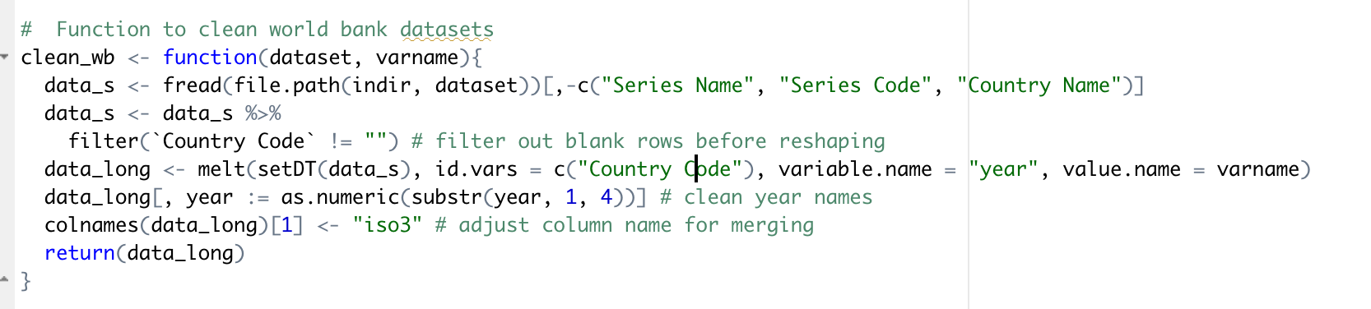
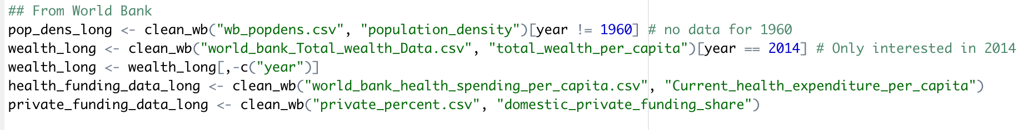

Slide 10
II. Modeling script
Reads in prepped csv
Includes 5 linear mixed models: filtered out archived, unnecessary exploratory models
Function to save model output to use coefficients in visualizations

Slide 11
III. Visualization script
Reads in prepped csv and model result csv’s
Function to save figures
Improved visualizations: x-axis labels, panel grid gone
Filtered down to figures of interest
8 figures total, looking at trends above and below median wealth per capita

Slide 12
Main findings
Using the linear mixed-effects model with random effects on time and location and including all locations in our dataset, we found an estimate of -0.00011 (p <0.0001) cases of MDR-TB per USD of laboratory expenditure investment
Including just locations below the median total wealth per capita, we found an estimate of -0.000056 (p <0.0001) cases per USD of laboratory expenditure investment.
For locations above the median total wealth per capita, we found an estimate of 0.00010 (p <0.0001) cases per USD of laboratory expenditure investment

Slide 13
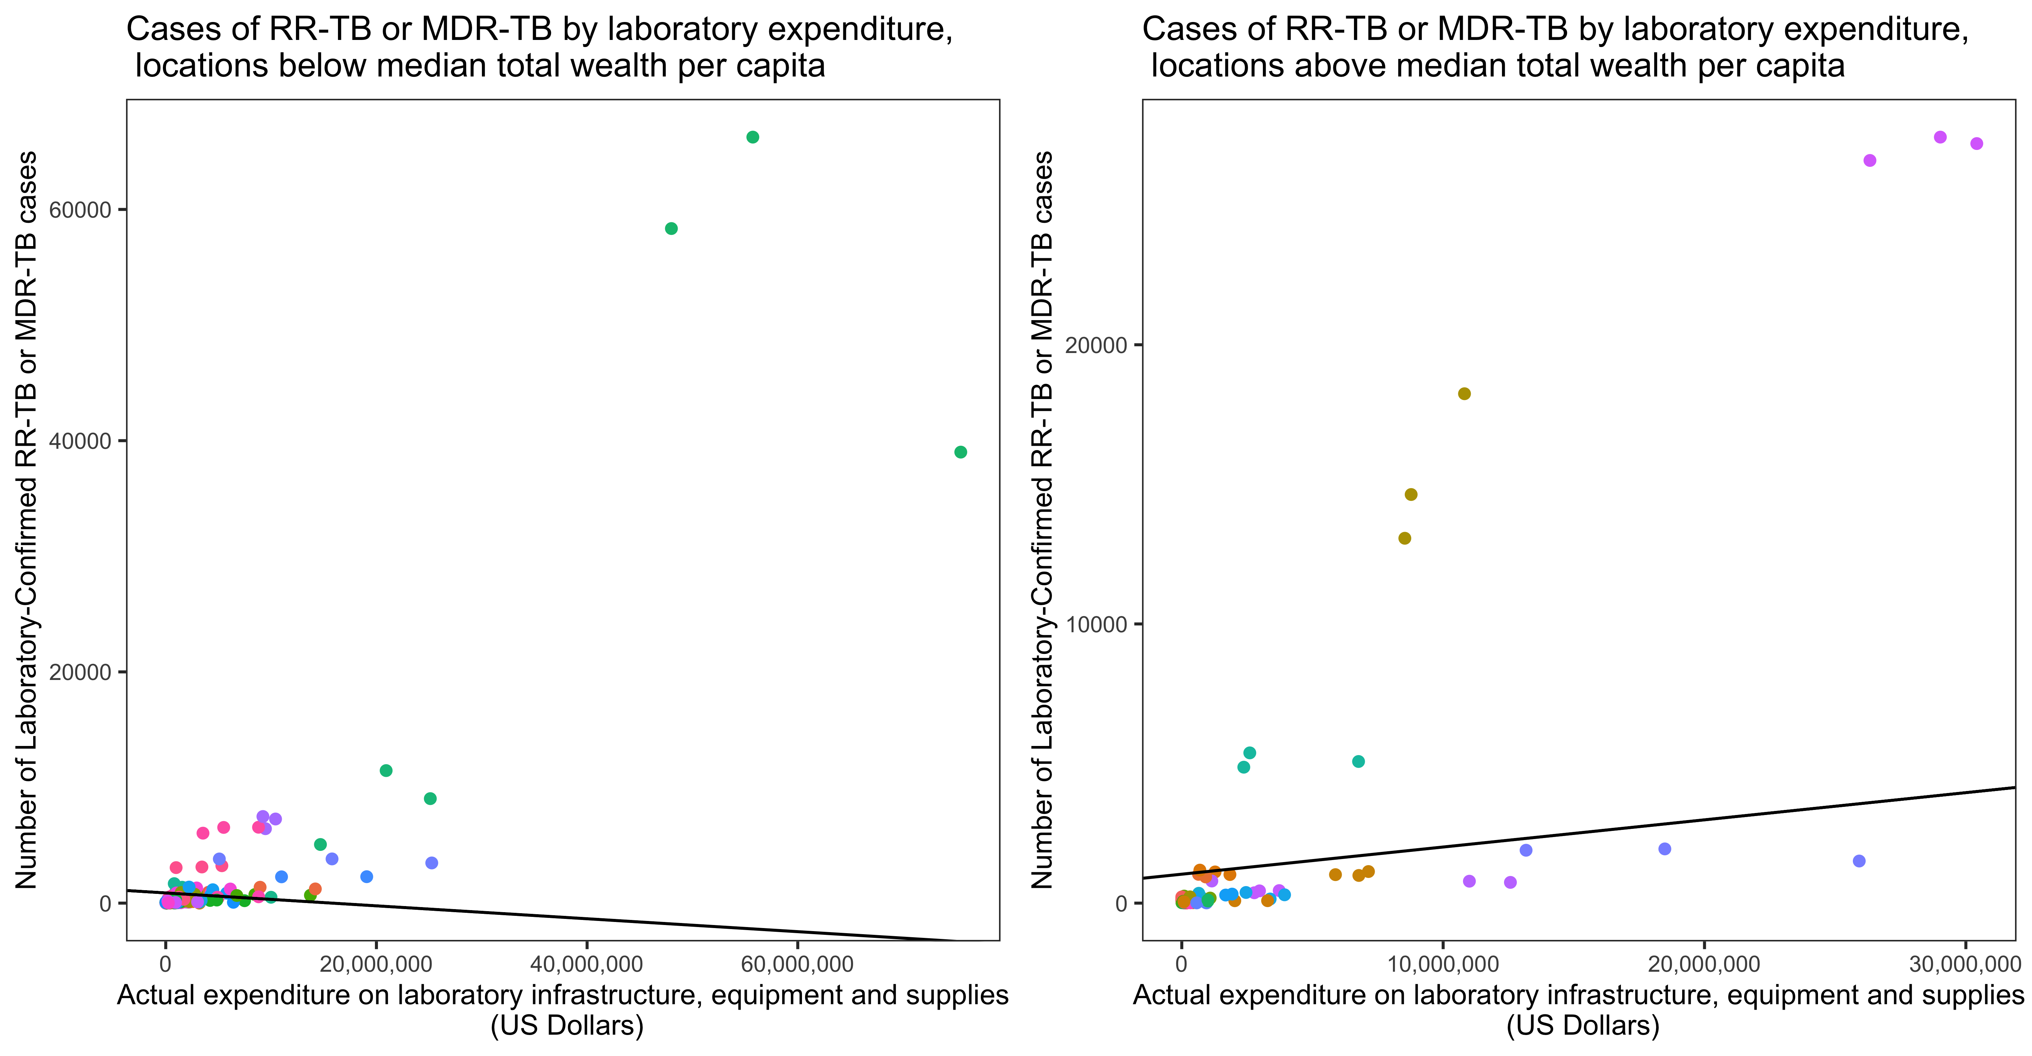

Slide 14
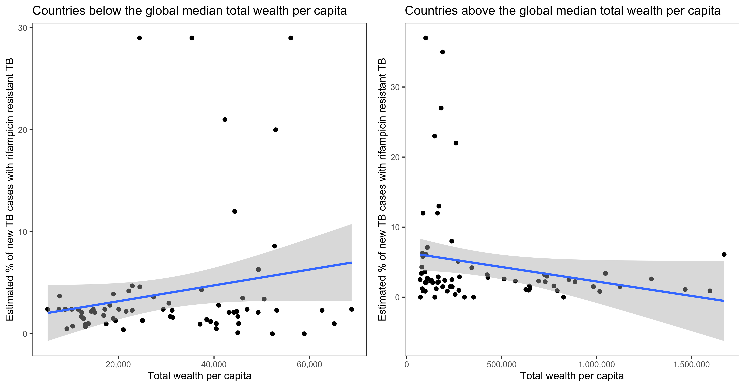

Slide 15
Future directions
Refine figures
Additional analyses with new test cartridge data
Update with most recent data
Examine effects of COVID-19

Slide 16
Summary
Made scripts more readable
Filtered out archived analyses
Split into three scripts
Improved ability to add or modify code
Added functions to make code more modular and efficient
Added use of data.table

Slide 17
Sources
Fact Sheet: Multidrug-Resistant Tuberculosis. CDC. 2016; published online May 4. https://www.cdc.gov/tb/publications/factsheets/drtb/mdrtb.htm (accessed Dec 13, 2021).
Tuberculosis. CDC. 2020; published online April. https://www.cdc.gov/globalhealth/newsroom/topics/tb/index.html (accessed Dec 13, 2021).
Tuberculosis. World Health Organization. https://www.who.int/westernpacific/health-topics/tuberculosis (accessed Dec 13, 2021).

Slide 18
Questions?

